Slide 1

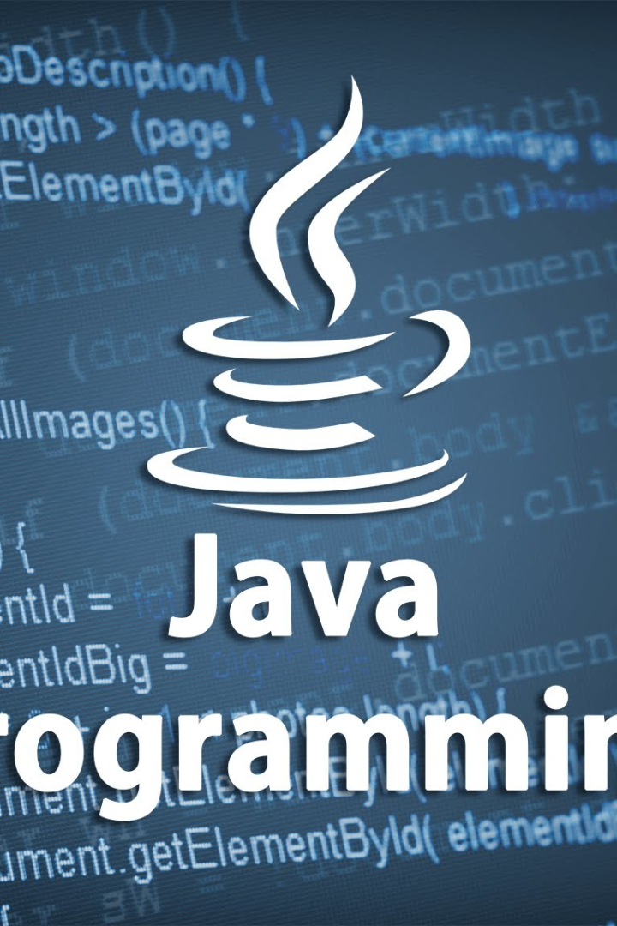
File Handling in Java
Java file handling allows you to read from and write to files, create new files, and perform basic file operations. It is an essential part of Java programming.
Js
By Trupthi S Anand

Slide 2

Basic File Operations
1
Create a File
2
Delete a File
Use the File class to create a new file using the name and path.
Use the delete() method of the File class to delete a file.
3
Check if a File Exists
4
Rename a File
Use the exists() method of the File class to check if a file exists.
Use the renameTo() method of the File class to rename a file.

Slide 3
Reading Files in Java
1
FileReader Class
Use the FileReader class to read character streams from a file.
BufferedReader Class
2
Use the BufferedReader class to read text from a character-input stream, buffering characters for efficient reading.
3
Scanner Class
Use the Scanner class to read text from a file as well as primitive types like int and double.

Slide 4
Writing Files in Java
FileWriter Class
BufferedWriter Class
Use the FileWriter class to write character streams to a file. It creates a new file or overwrites an existing one.
Use the BufferedWriter class to write text to a character-output stream, buffering characters for efficient writing.

Slide 5
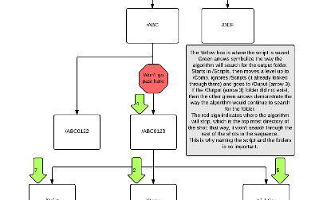


Working with Directories
Creating a directory
Listing files in a directory
Deleting a directory
Use the mkdir() method to create a directory in Java.
Use the list() method to list the files and directories of a directory.
Use the delete() method of the File class to delete a directory.

Slide 6

Java File Class Methods
isDirectory()
getParent()
Returns true if the file is a directory, false if it is a file.
Returns the pathname of the parent directory.
lastModified()
length()
Returns the number of milliseconds since January 1, 1970 when the file was last modified.
Returns the length of the file in bytes.

Slide 7
Best Practices for File Handling in Java
1
Close All Streams
Always close all file streams to avoid resource leakage.
Use try-with-resources
2
Use try-with-resources statement to automatically close resources.
3
Handle Exceptions
Be sure to properly handle exceptions to ensure your program runs smoothly.
Use Absolute File Paths
4
Use absolute file paths to avoid issues with relative paths.

